Slide 1
Project 3 – Deploying a Netflix clone on AWS
Using Tools :: 1. AWS EC2 setup → Launching & configuring an EC2 instance
2. Jenkins configuration → Installing Jenkins on EC2 & setting up necessary plugins and configuring Jenkins for continuous integration / countinuous deployment (CI / CD)
3. GitHub → Managing our source code with GitHub
4. OWASP → Implementing security scanning with OWASP dependency-check
5. Docker & DockerHub → Building and pushing docker images to dockerHub
6. DockerScout → scanning docker images for vulnerabilities
7. Docker Deployment → running the docker container on EC2
8. Email Notification → Configuring Jenkins to send email notifications on build success or failure
Steps → launch EC2 >> install jenking (you can also use jenkin on google in there web.) >> connect EC2 to jenkin >> install docker (docker have use 2 methods on your terminal or docker web.) >> jenking install plugins >> connect Jenkins to docker >> setup email notification on jankins >> write pipeline for access website (docker image) in jenkins >> write code for notification in jenkin

Slide 2
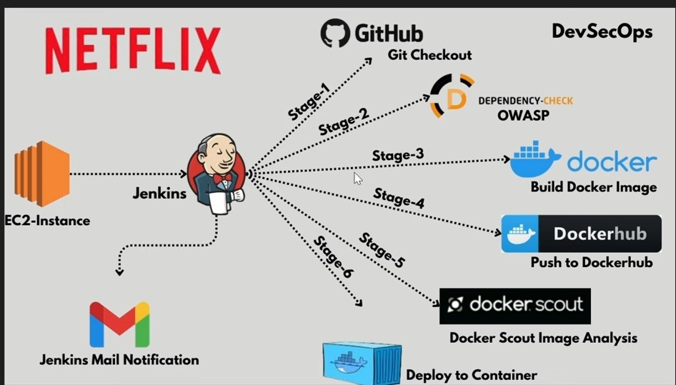
Here is all the stages (step)
Aws → EC2 >> Launch instances >> put name – select “ubuntu” – instance type “t2 large” – key pair – network “VPC” – select existing security group – 15 GB – launch instance >>
2. Jenkin installation → open in terminal (out side of aws) like Gitbash or MobXterm >> when connect to EC2 instance >> update instance “sudo apt update -y” >> convert ubuntu user to root user “sudo su” >> for create file “vi Jenkins.sh” now copy jenkin code from youtuber github “install Jenkins on ubuntu” “this is for insalling jenkin” than paste it terminal >> save “wq” >> write “LL (small character) ” >> provide excutign permission “sudo chmod 777 Jenkins.sh” >> for check again “LL (small case)” >> Ls (L write small case) >> run this file unit “sh Jenkins.sh” >> jenkin installation done

Slide 3
2. EC2 connect to jenkin >> copy (IPv4 address >> details >> EC2 >> AWS) >> open new tab >> put your IPv4 address on google (in last have 8080 required ?) >> now you can see jenkin (on google) – for psw (when done installation jenkin its show psw also on terminal) – 2nd way to get psw “ so copy path from google jenkin & paste in your terminal like this (sudo cat / var/lib/Jenkins/….password) “ >> copy psw & paste it on jenkin google (administrator psw) >> continue >> install suggested plugins (wait 2 min) >> create first admin user put (username – psw – cpsw – full name - email) >> save & continue >> save & finish >> start using jenkin
3. Install Docker :: copy code (youtuber github) >> paste in terminal >> for check “docker --version” >>
4. Go again jenkin (google) >> for install some plugin “go manage Jenkins (left side)” >> click plugins >> click “available plugins (left side)” >> search “docker” >> select (docker – docker commons – docker pipeline – docker Api – docker build app) >> search OWASP (select → owasp dependency check ) >> search email (select → email extension template) >> this is optional if you want to see your pipeline or output in beautiful way so install this “search blue ocean (select → blue ocean)” >> click Install button (right up side) (wait 2 min) >> after all plugin installation click “restart Jenkins when inst….” >> login >> click dashboard >> manage jenkin >> for integrate plugin with jenkin “go tools” >> go down “clicke → add dependency check (put name – click box install automatically “add installer – install from github.com – version dependency check 9.1.0”)” >> click add docker >> put (name – select check box install automatically (download from docker.com)) >> apply >> save
5. Go dockerhub.com (in google) (put username & password) >> repository >>
6. connect jenkin credential to docker >> go jenkin (google) >> manage jenkin >> credentials >> click (domains (global)) >> click add credentials button (Kind (select username with password) - put dockerhub username or psw – or put anything in ID or Description) >> create
7. Now setup email notification >> go gmail.com >> setting >> manage your google account >> security >> search “app password ” >> see details >> put your gmail psw >> next >> put name (app name) >> create >> copy password (save also on notepad – but remove all space in psw) >>
go jenkin (google) >> manage jenkin >> credentials >> select domain “global” (stores scoped to jenkins) >> click “add credentials” button >> kind (username or psw) – put username “gmail” or in password “put app psw that you copy & paste in notepad” – put anything ID or Description >> create
go jenkin (google) >> manage jenkin >> system >> go in down >> Extended E mail notification (SMTP server “smtp.gmail.com” – SMTP Port “465” select advanced “credential (select your mail credential) – select (Use SSL) ”) >> go more down E mail notification “SMTP server (smtp.gmail.com) – advanced (use SMTP authentication (user name “put your gmail ” – password “app psw that you created last & paste in notepad” – select (use SSL)) – SMTP port (465))” click box “test configuration by send… (than again put your gmail)” >> apply >> now click test configuration (it up side of box “test configuration by send…”) >> now you get mail on your gmail >> now go Default Triggers (it’s up side of E mail notification) “select box (always – success )” >> apply & save

Slide 4
8. Now write jenkin Pipeline >> go jenkin (google) >> + New item (left side) >> enter name (Netflix) (this is pipeline name) – select “pipeline” >> Ok >> now go down last write jenkin pipeline in (Script) → pipeline {
agent any
stages {
stage (“clean workspace”) {
steps {
cleanws ()
}
}
stage (“git checkout”) {
steps {
git branch : “main”, url : “https://github.com/v1jaygidefe/Netflix.git”
}
} for this link complete this down side step
// this red code you get from youtuber github stage(“OWASP FS SCAN”)
>> code >> copy “OWASP Stage” steps {
dependencyCheck add……….
despondencyCheckPublisher…..
}
}
}
}
Step → click “apply ” >> Click on new tab “pipeline syntax” (this is down side of script) >> go github (youtuber) – Netflix >> copy repository URL (go code button – now you can see url down to HTTPs than copy it’s) >> go pipeline syntax (that’s you open in new tab) >> sample step (git Git) – git “repository URL (paste URL that you copy down to HTTPS from Github)” – branch name (main) (for branch name go github code you can see branch name upside of all code file & also writed branch on side) – if github file have private repository so (you have to give github credential to jenkin than select that’s credential than click “generate pipeline script” == if github has public repository so directly click “generate pipeline script” >> than copy generated pipeline script & paste it upside in code >> apply

Slide 5
This full pipeline script code :: pipeline {
agent any
stages { // clean the current workspace
stage (“clean workspace”) {
steps {
cleanws ()
}
}
stage (“git checkout”) { // it is take source code from github repository
steps {
git branch : “main”, url : “https://github.com/v1jaygidefe/Netflix.git”
}
}
stage(“OWASP FS SCAN”) // os is scan all the file of our project
steps {
dependencyCheck add……….
despondencyCheckPublisher…..
}
}
stage (“Build Docker Image”) { // build docker IMG
steps {
sh “docker build –t Netflix .”
}
}

Slide 6
stage (“Tag & Push to Dockerhub”)
steps {
script {
withDockerRegistry(CredentialsId : ‘docker’) {
sh “docker tag Netflix vijaygiduthuri/Netflix:latest” // this is for tag docker image
sh “docker push vijaygiduthuri/Netflix:latest” // this is for push docker image to docker hub
}
}
} // for this red text complete this step
//for scan docker IMG stage (“Docker Scout Image Analysis”) {
steps {
script {
withDockerRegistry(credentialsId: ‘docker’) {
sh “docker-scout quickview vijaygiduthuri/Netflix:latest” // “vijaygiduthri/Netflix:latest” is docker img name
sh “docker-scout cves vijaygiduthuri/Netflix:latest”
sh “docker-scout recommendations vijaygiduthuri/Netflix:latest”
}
}
}
}
//for run docker container stage (“Deploy to docker container”)
steps {
sh “docker run –itd –name Netflix –p 4000:80 netflix:latest” // “netflix” is container name // why 4000 because 4000 on github code
}
}
//after write this blue code than click apply than go again pipeline syntax >> sample step (withDOckerRegistry sets up Docker registry endpoint) – registry credentials (select docker credential that’s you created last) – click button “generate pipeline scripts”
// you can see from terminal (you have docker image or not) → write on terminal (docker images) – for check docker container (docker ps -a)

Slide 7
Apply
>> go youtuber github code & copy “Jenkins mail notification script” & paste it jenkin pipeline script
// continue pipeline script
……..
………………….
…………………..
// change mail id last in script
}
>> apply >> save >> click “build now” (left side) now build start (wait 30 min)
Fail // docker build –t Netflix → Error :: permission denied var/run/docker.sock…. (for permission → go terminal >> write (sudo chmod 777 /var/run/docker.sock) >> enter) >> again click “Build Now”
// also you get failed mail
>>> after build >> go docker hub (google) & refresh it than you will see docker IMG
Fail // docker-scout : not found (go terminal >> write “docker login” >> now provide dockerHub username or psw >> copy code “install docker scout” (go youtuber github -> code -> install docker scout -> copy code -> paste it on terminal) >> go jenikin & again “build now”)
9. access Netflix clone >> go AWS “EC2” copy “public IP” >> paste it on google & write in last .4000 >> now you can see final OUtput

